Slide 1
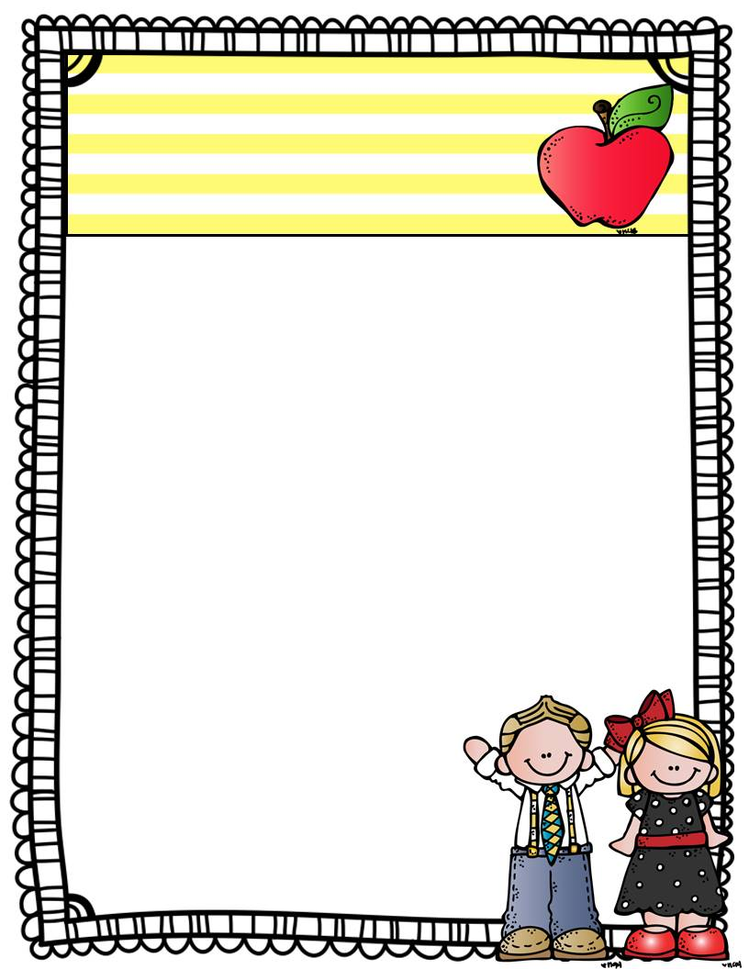
Miss Leonard’s
Class News
What’s Happening in...
October 2017
Our first month of school has been busy! We have meet new friends, learned classroom routines and rules and jumped into learning! During Literacy students have learned letter sounds, capital and lowercase and practiced the beginning sound of words. Students have been writing beginning sounds during writing time as well. In Math we have reviewed shapes, colors, position words and categorizing. We have also been working on number writing, number order and recognition of 1-10.
In Science we have explored the apple lifecycle.
Reminder: We are collecting box tops. Due on Oct 24th
Dates to remember
Wednesday, October 11: 12:55 dismissal
Monday, October 16 and Tuesday, October 17: Early dismissal: Parent Teacher Conferences
Friday, October 20: No School
Thank You, Miss Leonard

